Slide 1
3 Reasons to Use Pressbooks . …for someone who has never used Pressbooks
James R. Paradiso
Instructional Designer & AIM Program Coordinator for Open Education
Center for Distributed Learning, IDL6543 Cohort #3

Slide 2
#1
You think Webcourses “Pages” are just a little too boring.

Slide 3
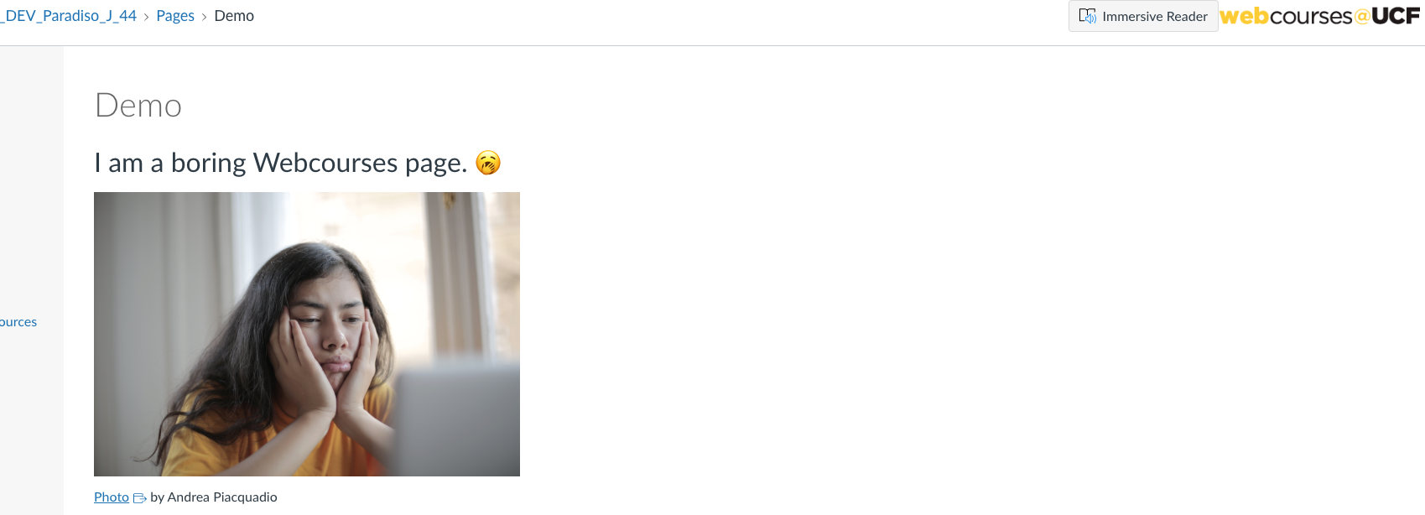
Dr. Karina Cespedes, HUM2020

Slide 4
#2
You think formative assessment is crucial to learning.

Slide 5
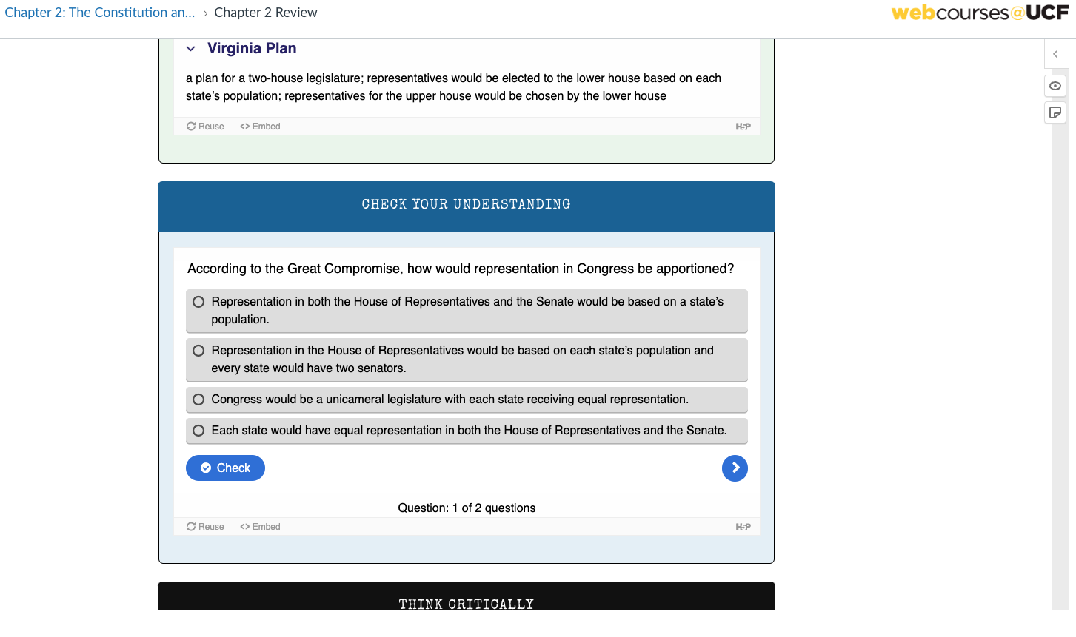
Dr. Bruce Wilson, POS2041
Dr. Nicole Lapeyrouse, CHM2045C

Slide 6
#3
You would like your (and your students) work to have an impact beyond the confines of the classroom.

Slide 7
