Slide 1
EME6613 Instructional Systems Design Instructional Development
Instructor Guides
Paulina Bzdun
University of Central Florida
Class Notes
Fall 2021
Notes:
Designer’s Notes:
The image source is: https://www.slideshare.net/tamersafety/instructor-guide-28961485
No audio for this slide.
Next button links to slide 2.

Slide 2
Why Generate an Instructor Guide?
Systematic Design: including the development of an Instructor Guide, takes significant time and resources
Return on investment/cost benefit: By generating an Instructor Guide, the instructional materials can be used across contexts with qualified instructors across similar contexts
Return on investment/cost benefit: In other words, resulting program/materials are replicable and generalizable
Notes:
Designer’s Notes:
No audio for this slide.
Next button links to slide 3.

Slide 3
Objectives
Given an instructional treatment plan, develop an instructor guide that depicts what instructors should do during synchronous and asynchronous components of an instructional unit
Notes:
Designer’s Notes:
No audio for this slide.
Next button links to slide 4.

Slide 4
1.0
Generate an overview of objectives, background, and target audience
Figure 8.1: Steps for Creating an Instructor Guide
*Click to see each step for further details*
3.0
Generate a course or training schedule
7.0
List instructor and student materials for asynchronous and
synchronous sessions
6.0
Does Guide include all beginning components?
5.0
Generate a “How to use the Instructor Guide”
Yes
2.0
Generate a course or training map
No
M
4.0
Generate an overview for each unit of training/instruction
8.0
Design and sequence instructional events or activities
Menu Links
Front-End Information (Steps 1-5)
Designing Instructional Events and Activities (Steps 7-10)
Back-End Information (Steps 11-14)
9.0
Create resources and/or visuals for each instructional
event or activity
12.0
Does Guide include all components?
14.0
Generate a Table of Contents
11.0
Generate an Appendix with instructor and student resources
M
10.0
Generate instructor notes for each instructional event or activity
Go back to steps 1-11 based on nature of revisions
13.0
Revise Instructor Guide
Figure 8.1 is a stepwise analysis that breaks down steps that learners follow to create an Instructor Guide. The steps are described in more detail in the menu links above.
Notes:
Narrative:
The following Figure is a stepwise analysis of creating an Instructor Guide. The analysis includes 14 steps that can be followed in order or simultaneously as depicted in the figure. To learn more about each step, click on the boxes that will link to the corresponding slides. You can press the home button throughout the PowerPoint to come back to this slide and continue learning more about each step.
Designer’s Notes:
The audio button should include the audio with the narrative script above.
This will be the homepage that will be represented by the home button on the following slides. This is so that they can see the figure again as well as access the menu links for more information.
Menu link titled “Front-end Information (Steps 1-5)” links to slide 5.
Menu link titled “Designing Instructional Events and Activities (Steps 7-10)” links to slide 13.
Menu link titled “Back-end Information (Steps 11-14) links to slide 21.

Slide 5
Front-End Information in an Instructor Guide:
An overview of objectives, background, and target audience
A course or training map
A course or training schedule
An overview for each unit of training or instruction
A “How to Use This Instructor Guide”
Notes:
Narrative:
Steps 1 through 5 cover the front-end information in an Instructor Guide. Step 6 is a decision diamond that asks whether you have included all of these components, so it will not be discussed in further detail.
The beginning components of an Instructor Guide include your:
Overview of objectives, background, and target audience, a course or training map, a course or training schedule, an overview for each unit of training or instruction, and a “How to Use This Instructor Guide”.
View steps 1 through 5 to learn more about each of the beginning components.
Designer’s Notes:
The audio button should include the audio with the narrative script above.
The home button links to slide 4.
Next button links to slide 6.

Slide 6
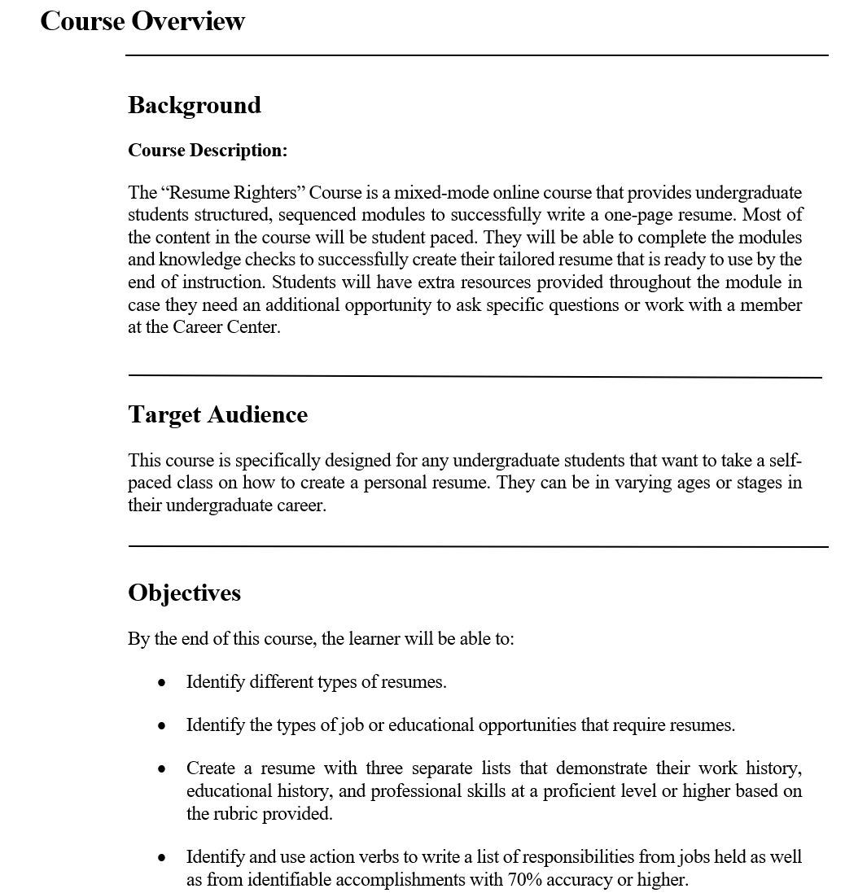
Step 1: Generate an Overview of Objectives, Background, and Target Audience
This part of the Instructor Guide gives a brief overview of:
Course Objectives
Background
Target Audience
Figure 8.2: Course Overview Example
Notes:
Narrative:
Step 1 is to generate an overview of objectives, background, and target audience.
The overview of the course or training objectives are the objectives that the learners should accomplish by the end of the course. This comes from your Goal Analysis.
The background should include brief information about the course or training. This can include what the goal of the course is, details about the course, who might take the course, how or where the course may be offered or taught, or any other details you feel explain the purpose of the course. This comes from your Performance and Context Analysis.
The overview of the target audience should include the intended learners for your course or training. This comes from your Learner Analysis.
Figure 8.2 shows an example from an Instructor Guide that includes the background, the target audience, and the course objectives.
Designer’s Notes:
The audio button should include the audio with the narrative script above.
The home button links to slide 4.
Next button links to slide 7.

Slide 7
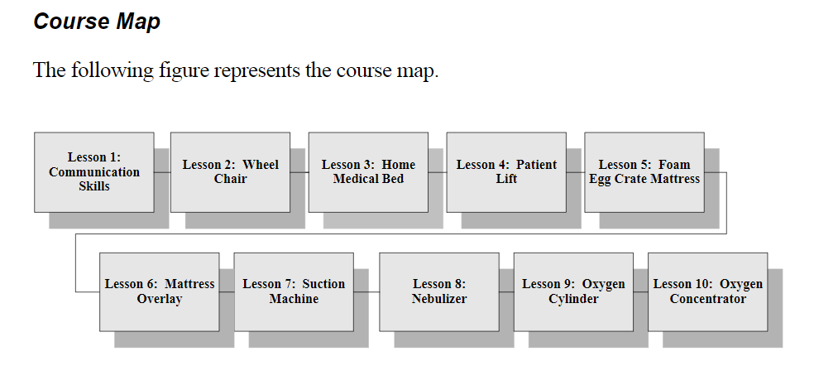
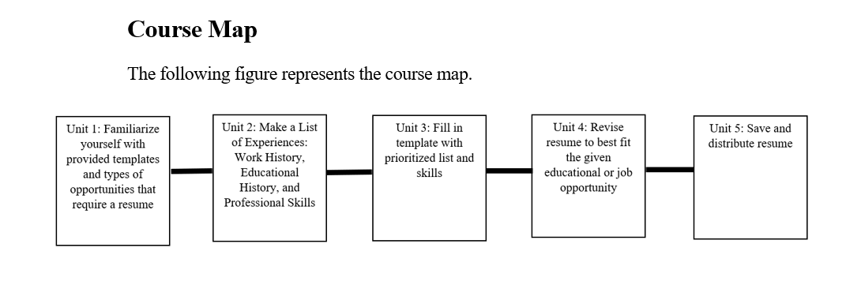
Step 2: Generate a Course or Training Map
A course or training map presents the units or modules in the course
Figure 8.3: Course Map Example 1 Figure 8.4: Course Map Example 2
Notes:
Narrative:
Step 2 is to generate a course or training map.
A course or training map presents the units or modules in the way that they are meant to be completed or instructed.
The units of instruction may have been included in your Goal Analysis.
Figures 8.3 and 8.4 shows examples of how two Instructor Guides structured their course map.
Designer’s Notes:
The audio button should include the audio with the narrative script above.
The home button links to slide 4.
Next button links to slide 8.

Slide 8
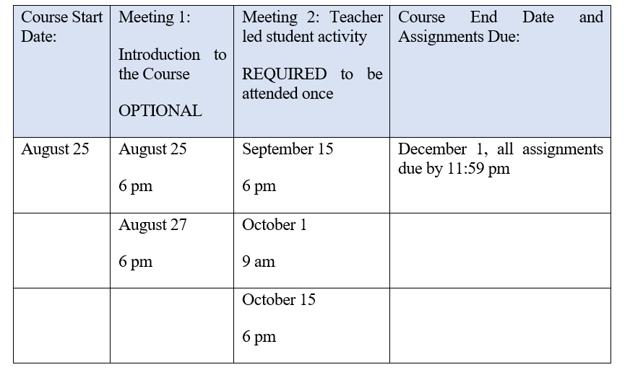
Step 3: Generate a Course or Training Schedule
List the dates and times of instruction
Distinguish between asynchronous and synchronous dates
Figure 8.5: Course Schedule Example
Another example
Notes:
Narrative:
Step 3 is to generate a course or training schedule.
A course or training schedule lists the dates and times for both asynchronous and synchronous instruction.
Synchronous meetings should be listed as specific times and dates.
Asynchronous meetings can be listed as time frames or due dates for assignments or assessments.
Figure 8.5 shows an example of how an Instructor Guide structured their course schedule.
You can click on the arrow to see another example of a course schedule.
Designer’s Notes:
The audio button should include the audio with the narrative script above.
The home button links to slide 4.
The arrow button links to slide 9.

Slide 9
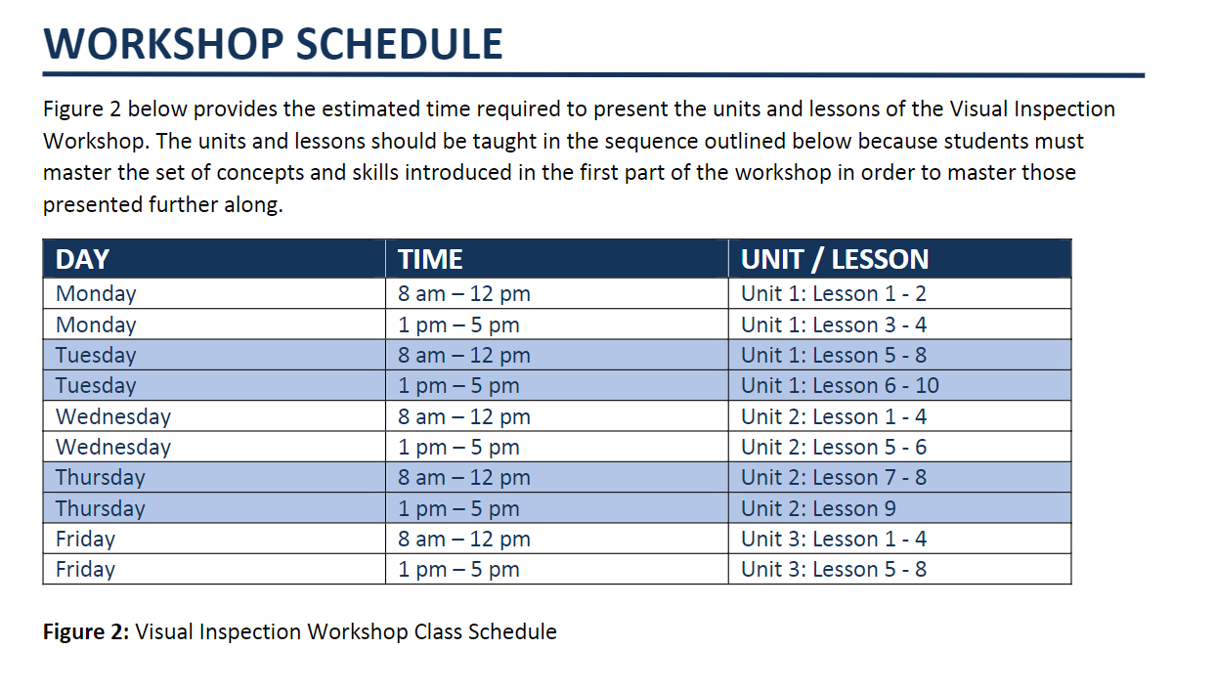
Step 3: Generate a Course or Training Schedule
Figure 8.6: Course Schedule Example 2
Notes:
Designer’s Notes:
There is no narrative or audio for the slide.
The home button links to slide 4.
Next button links to slide 10 .

Slide 10
Step 4: Generate an Overview for Each Unit of Training or Instruction
The unit or lesson overview should include important information such as:
Unit objective
Unit schedule
Time requirements
Instructional Strategy (found in your Instructional Treatment Plan)
Student materials
Instructor Materials
See an example
Notes:
Narrative:
Step 4 is to generate an overview for each unit of training or instruction.
Each unit or lesson should have a brief overview before providing the actual lesson plan.
The unit or lesson overview should include important details an instructor should know in order to prepare for instructing the lesson or training.
The unit or lesson overview should include important information such as:
The unit objective, the unit schedule, time requirements, the instructional strategy found in your Instructional Treatment plan, student materials, and instructor materials.
After the unit or lesson overview, you will provide the lesson plan that is detailed further in steps 7 through 11.
Click on the arrow to see an example of a lesson overview.
Designer’s Notes:
The audio button should include the audio with the narrative script above.
The home button links to slide 4.
The arrow button links to slide 11.

Slide 11
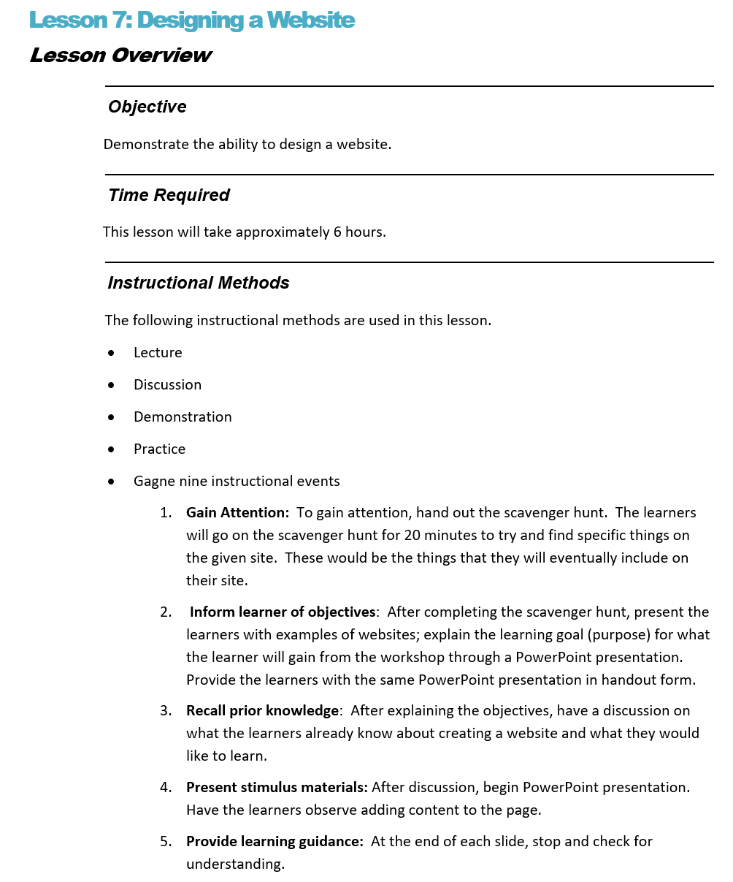
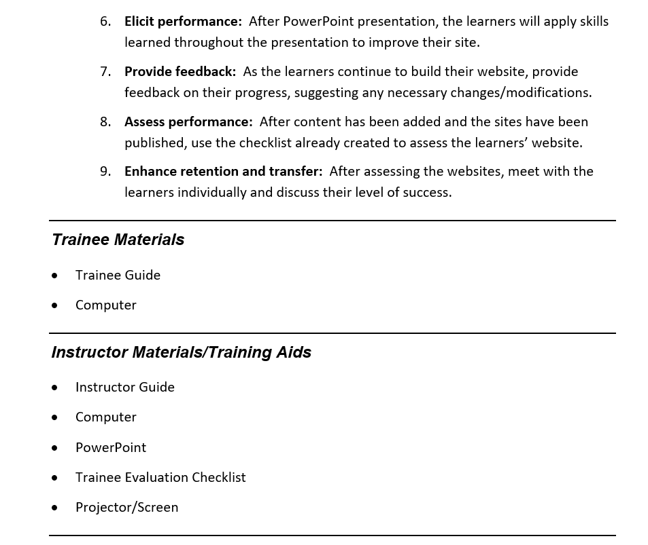
Objective
Time Requirements
Student Materials
Instructor Materials
Instructional Strategy
Figure 8.7: Lesson Overview Example
Notes:
Designer’s Notes:
There is no narrative or audio for the slide.
The home button links to slide 4.
Next button links to slide 12 .

Slide 12
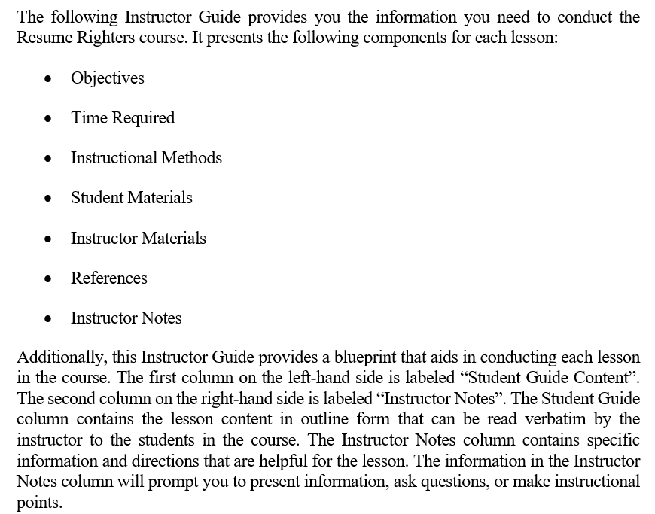
Step 5: Generate a “How to Use the Instructor Guide”
Information that is necessary for an Instructor to understand or expect
More detailed explanation of certain components
Figure 8.8: “How to Use the Instructor Guide” Example 1 Figure 8.9: “How to Use the Instructor Guide” Example 2
Notes:
Narrative:
Step 5 is to generate a “How to use the Instructor Guide”.
A “How to use this Instructor Guide” is a brief overview of any information you think is necessary for an instructor to understand or expect before looking at the course lessons and units.
This information can include a description of certain components of the Instructor Guide you think need a more detailed explanation.
Here is an example of something you can include in a “How to use the Instructor Guide”.
The table in each unit has two columns. The first column includes what the students should see or do, and the second column includes what the instructor should say or do.
Designer’s Notes:
The audio button should include the audio with the narrative script above.
The home button links to slide 4.

Slide 13
Designing Instructional Events and Activities:
List instructor and student materials for asynchronous and synchronous sessions
Design and sequence instructional events and activities
Create resources and/or visuals for each instructional event or activity
Generate instructor notes for each instructional event or activity
Notes:
Narrative:
Steps 7 through 10 discuss how to create a table where you design and sequence the instructional events and activities in your Instructor Guide.
To create this table, you should be able to list both instructor and student materials for asynchronous and synchronous sessions, design and sequence the instructional events and activities, create resources and visuals for each instructional event or activity, and generate instructor notes for each instructional event or activity.
These steps can be done in order or simultaneously throughout the process.
View steps 7 through 10 to learn more about how to design your instructional events and activities.
Designer’s Notes:
The audio button should include the audio with the narrative script above.
The home button links to slide 4.
The next button links to slide 14.

Slide 14
Step 7: List Instructor and Student Materials for Asynchronous and Synchronous Sessions
In the lesson overview where the student and instructor materials are stated, specify if they are synchronous or asynchronous
Figure 8.10: Instructor Materials with Asynchronous or Synchronous Materials
Another example
Notes:
Narrative:
In this course, we are creating instruction or training that provides both asynchronous and synchronous components. So Step 7 is to list the instructor and student materials for both the asynchronous and synchronous sessions. Your lesson may be fully synchronous, asynchronous, or both, so it is important to specify what materials will be needed for each.
In your lesson overview right before the lesson plan, you should have a section for both Instructor Materials and Student Materials. Here you will specify which materials are synchronous, asynchronous, or both. Doing so will help you label the parts of the lesson plan for the instructor that are asynchronous or synchronous.
Designer’s Notes:
The audio button should include the audio with the narrative script above.
The home button links to slide 4.
The arrow button links to 15.

Slide 15
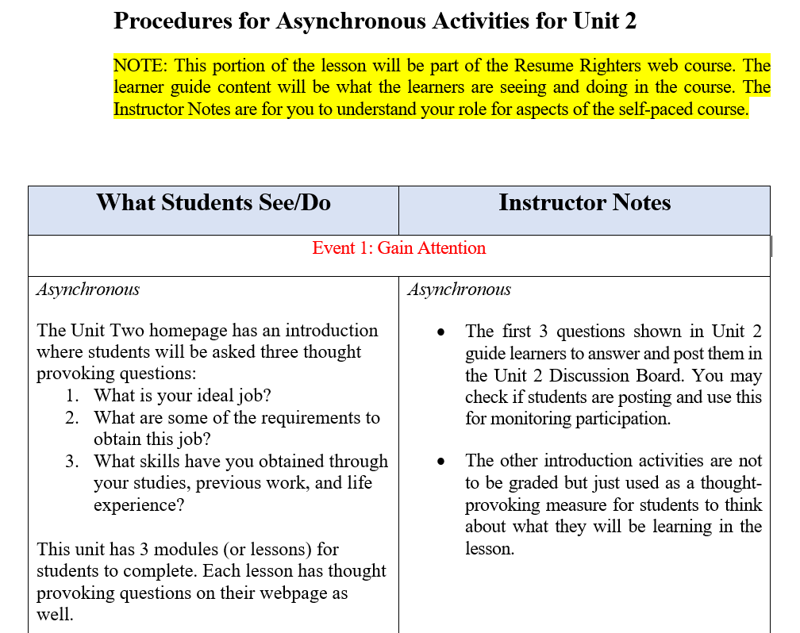
Step 7: List Instructor and Student Materials for Asynchronous and Synchronous Sessions
Provide a description in the lesson plan for asynchronous or synchronous materials
Figure 8.11: Asynchronous or Synchronous Materials Example 1 Figure 8.12: Asynchronous or Synchronous Materials Example 2
Notes:
Narrative:
Now that you specified which materials are synchronous, asynchronous, or both in the lesson overview, we will do it within the lesson plan. The lesson plan should have two columns, one for what the students should see or do, and one for instructor notes. Specify whether those student or instructor materials in the lesson are synchronous or asynchronous.
Designer’s Notes:
The audio button should include the audio with the narrative script above.
The home button links to slide 4.
Next button links to slide 16.

Slide 16
Step 8: Design and sequence instructional events or activities
Column for what Students should see or do
Column for Instructor Notes
Row that specifies your instructional strategy and correlated instructional event
Instructional Strategy/ Event
What Students See/Do Instructor Notes
Continue
Figure 8.13: Instructional Events or Activities Example 1
Notes:
Narrative:
Step 8 is to design and sequence your instructional events or activities.
First, create a two-column chart that has a “What Students See or Do” column, and an “Instructor Notes” column.
The What Students See or Do column includes a thumbnail, screenshot, or icon of the resource students should see or do. This can include PowerPoints, handouts, assessments, or any other materials. Then, you can describe what the students should be doing during this instructional event or activity.
The Instructor Notes Column should give detailed notes to the instructor on what they should do, say, present, or any other important details needed for the instructional event.
In your Instructional Treatment Plan, you specified your instructional strategy. Each instructional strategy gives events the theory believes elicits learning. When you are teaching that instructional event you specified in your Treatment Plan, create a row above “What Students See or Do” and “Instructor Notes” that names the instructional event.
For example, if you chose Gagne’s Nine Instructional Events, list which instructional event it correlates with, such as Event 1: Gain Attention. Put this in a row above the two columns. Do this for each event.
The other part of Step 8 is to sequence the instructional events in a logical order that the instructor should follow to complete the lesson plan. Remember to include each step or event from your instructional strategy and follow the suggested sequence of instructional events .
Designer’s Notes:
The audio button should include the audio with the narrative script above.
The home button links to slide 4.
The arrow button links to 17.

Slide 17
Step 8: Design and sequence instructional events or activities
Column for what Students should see or do
Column for Instructor Notes
Row that specifies your instructional strategy and correlated instructional event
What Students See/Do Instructor Notes
Instructional Strategy/ Event
Figure 8.14: Instructional Events or Activities Example 2
Notes:
Designer’s Notes:
There is no audio for this slide.
The home button links to slide 4.
Next button links to slide 18.

Slide 18
Step 9: Create Resources and/or Visuals for Each Instructional Event or Activity
Provide a thumbnail, screenshot, or icon of the resource
Provide the name of the resource located in the Appendix
Figure 8.15: Screenshot Resource Example
Notes:
Narrative:
Step 9 is to create resources and visuals for each instructional event or activity. Provide a thumbnail, screenshot, or icon of the resource and place it in the What Students See or Do column. In the Instructor Notes, reference the name of the full resource as it is found in the Appendix so that they can locate, save, or print the resource.
Designer’s Notes:
The audio button should include the audio with the narrative script above.
The home button links to slide 4.
Next button links to slide 19.

Slide 19
Step 10: Generate Instructor Notes for Each Instructional Event or Activity
The Instructor Notes should have important details that would allow any qualified instructor or trainer to be able to teach the unit or lesson
Detailed notes may include:
What they should do
What it is suggested for them to say
What materials they may need to present
Whether it is asynchronous or synchronous
See examples
Notes:
Narrative:
Step 10 focuses on Generating Instructor Notes for each Instructional Event or Activity. Remember, one of the benefits of Instructor Guides are that the instructional materials can be used across contexts with qualified instructors across similar contexts.
This is why it is crucial that the instructor notes include all important and specific details that would allow any qualified instructor or trainer to be able to teach the unit or lesson. This allows for the program and materials to be replicable and generalizable.
Detailed Instructor notes may include: what they should do, what it is suggested for them to say, what materials they may need to present, whether it is asynchronous or synchronous, and what instructional event or strategy is being used.
Click on the arrow to see different types of Instructor Notes.
Designer’s Notes:
The audio button should include the audio with the narrative script above.
The home button links to slide 4.
The arrow button links to slide 20.

Slide 20
Step 10: Generate Instructor Notes for Each Instructional Event or Activity
Figure 8.16: Instructor Notes Example 1 Figure 8.17: Instructor Notes Example 2
Notes:
Designer’s Notes:
There is narrative for this slide.
The home button links to slide 4.

Slide 21
Back-End Information in an Instructor Guide:
An Appendix
Revisions and Final Edits
A Table of Contents
Notes:
Narrative:
Steps 11 through 14 cover the back-end information in an Instructor Guide. Step 12 is a decision diamond; thus it will not be discussed in more detail.
The back-end components of an Instructor Guide include your:
appendix, a final revision of the entire guide for any grammatical or content issues, and a table of contents.
View steps 11 through 14 to learn more about each of the back-end components.
Designer’s Notes:
The audio button should include the audio with the narrative script above.
The home button links to slide 4.
Next button links to slide 22.

Slide 22
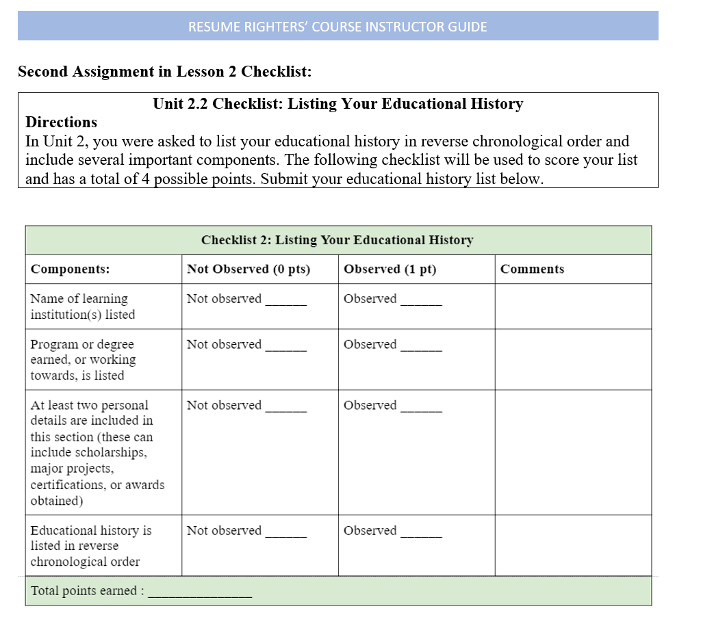
Step 11: Generate an Appendix with Instructor and Student Resources
Items in the Appendix may include, but are not limited to:
Checklists
PowerPoints (Handout Slides or Files)
Rubrics
Assignments
Figure 8.18: Appendix Resource Example
Notes:
Narrative:
Step 11 is to generate an appendix with instructor and student resources. In the Instructional Events or Activities, you only put a thumbnail, screenshot, or icon of the student or instructor resource.
Create an Appendix at the end of your Instructor Guide that provides each full resource so that instructors can distribute, save, or upload the resources for the course or training. The Appendix includes all of the resources for both the asynchronous and synchronous components in the course or training.
Items in the Appendix may include, but are not limited to: Checklists, PowerPoint Slides or PowerPoint Handouts, Rubrics, Assignments, or Assessments
Designer’s Notes:
The audio button should include the audio with the narrative script above.
The home button links to slide 4.
Next button links to slide 23.

Slide 23
Step 13: Revise the Instructor Guide
The Instructor Guide should include all the components from Steps 1-12.
You may look at the Instructor Guide Checklist to see whether you included all the components: Instructor Guide Checklist PDF
This step includes any final revisions including:
Proofreading
Formatting
Editing any elements or components of the Instructor Guide
Notes:
Narrative:
Step 12 in figure 8.1 is a decision diamond that asks if your guide includes all of the components of an instructor guide specified in steps 1 through 11. If you chose yes, you may continue to step 14. If you chose no, then you go to step 13.
Step 13 is to revise any components of your instructor guide.
You can download the Instructor Guide Checklist on this slide to see whether your instructor guide has all of the components.
Revising also includes proofreading, formatting, or editing any other elements in your Instructor Guide.
Designer’s Notes:
The audio button should include the audio with the narrative script above.
The home button links to slide 4.
Next button links to slide 24.

Slide 24
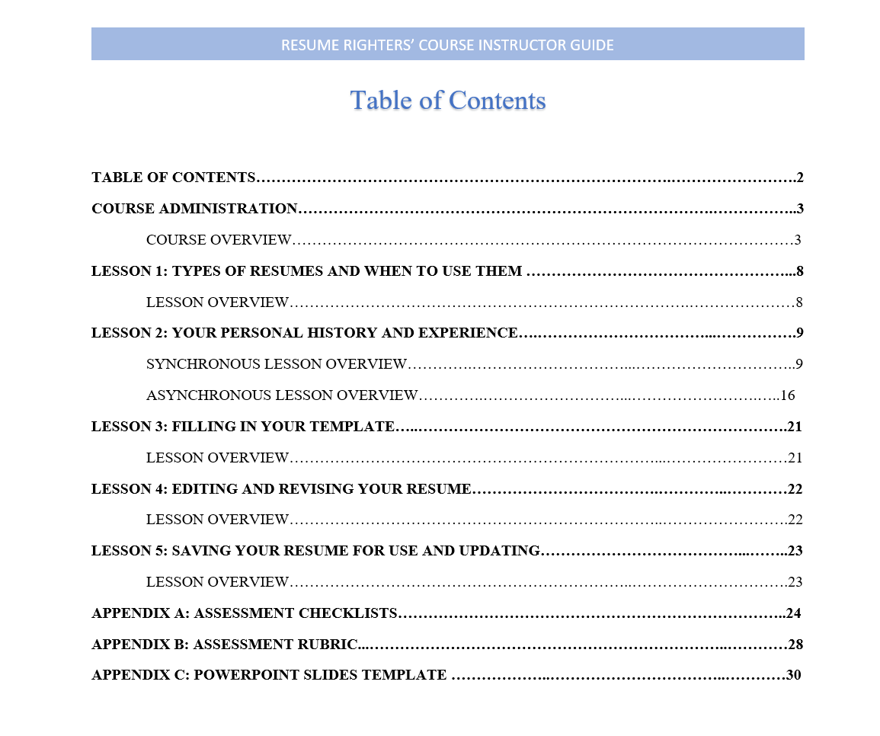
Step 14: Generate a Table of Contents
Create a Table of Contents at the beginning of the Guide
Include headings and page numbers of important sections
Figure 8.19: Table of Contents Example
Notes:
Narrative:
Step 14 is to generate a Table of Contents. When the Instructor Guide has been revised and completed, create a Table of Contents at the beginning of the Instructor Guide that includes the headings and page numbers of important sections. This will be the final step to ensure that all pages correlate with the corresponding sections within your guide.
Designer’s Notes:
The audio button should include the audio with the narrative script above.
The home button links to slide 4.

Slide 25
Resources
Dick, W., Carey, L., & Carey, J. O. (2015). The Systematic Design of Instruction (8th edition),
Upper Saddle River, NJ: Pearson.
Hirumi, A. (2018). Assignment 04 description, examples, and rubrics. [Rubric]. Canvas@UCF. https://webcourses.ucf.edu/login/canvas
Hirumi, A. (2018). Class Notes. [PowerPoint slides]. Canvas@UCF. https://webcourses.ucf.edu/login/canvas
Hirumi, A. (n.d.). Instructor Guide Sample Hospice. [Class handout]. University of Central Florida, EME6613.
Hirumi, A. (n.d.). Instructor Guide Sample Integrating Tech. [Class handout]. University of Central Florida, EME6613.
Hirumi, A. (2009). Instructor Guide Ticket Handling. [Class handout]. University of Central Florida, EME6613.
Hirumi, A. (2017). Welding Wonders- A03 Instructor Guide FINAL. [Class handout]. University of Central Florida, EME6613.
Notes:
Designer’s Notes:
The audio button should include the audio with the narrative script above.
The home button links to slide 4.

